Slide 1
Chapter 10 Notes

Slide 2
Agenda
Chi-square tests
Non-parametric tests
Wilcoxon Signed Rank Test
Mann-Whitney Test

Slide 3
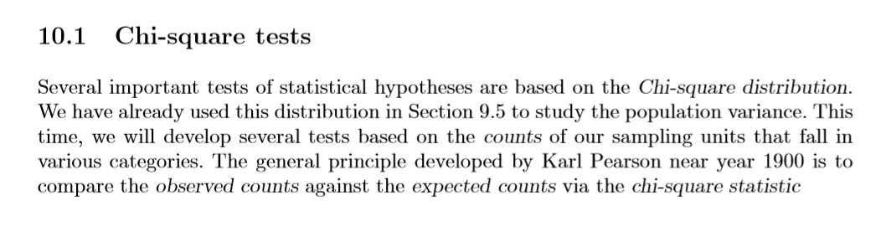
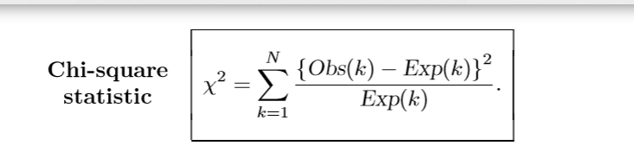
Chi-square Test
Observed counts vs Expected counts

Slide 4
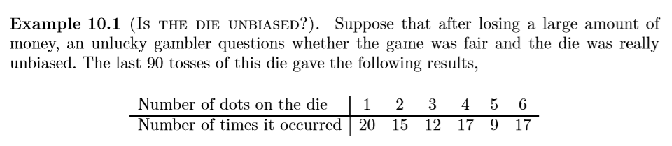
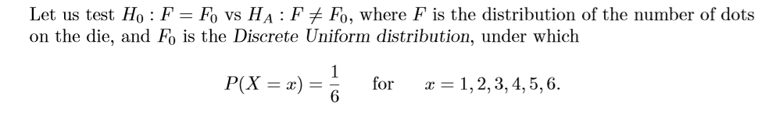
Chi-square test Example

Slide 5
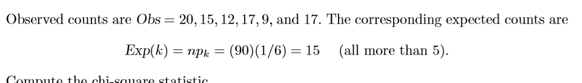
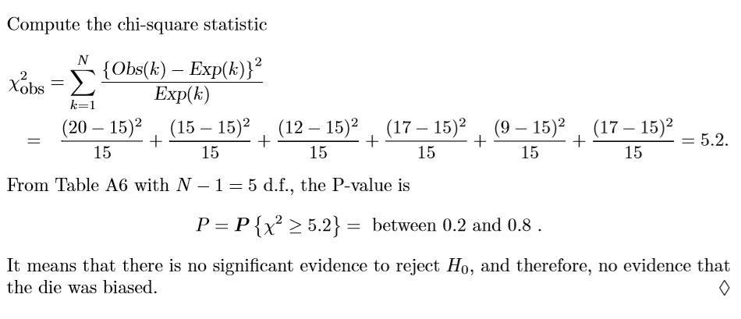
Chi-square test contd..

Slide 6
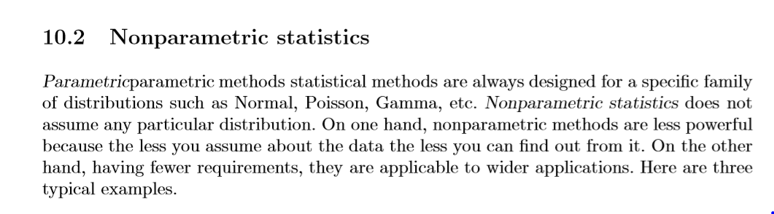
Non-Parametric Statistics

Slide 7
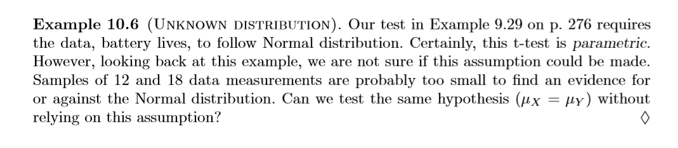
Examples of Non-Parametric Statistics

Slide 8
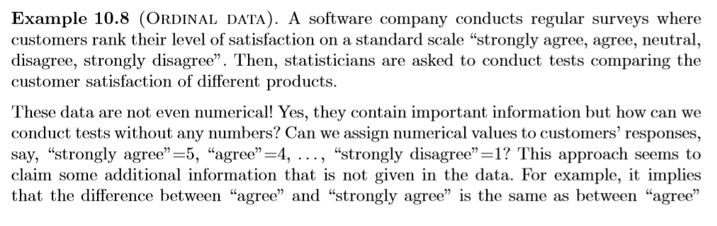
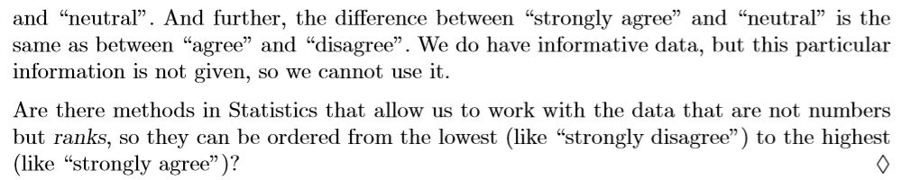
Examples of Non-Parametric Statistics

Slide 9
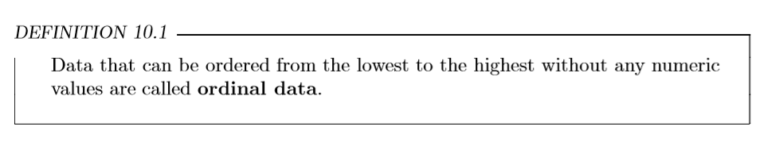
Ordinal Data

Slide 10
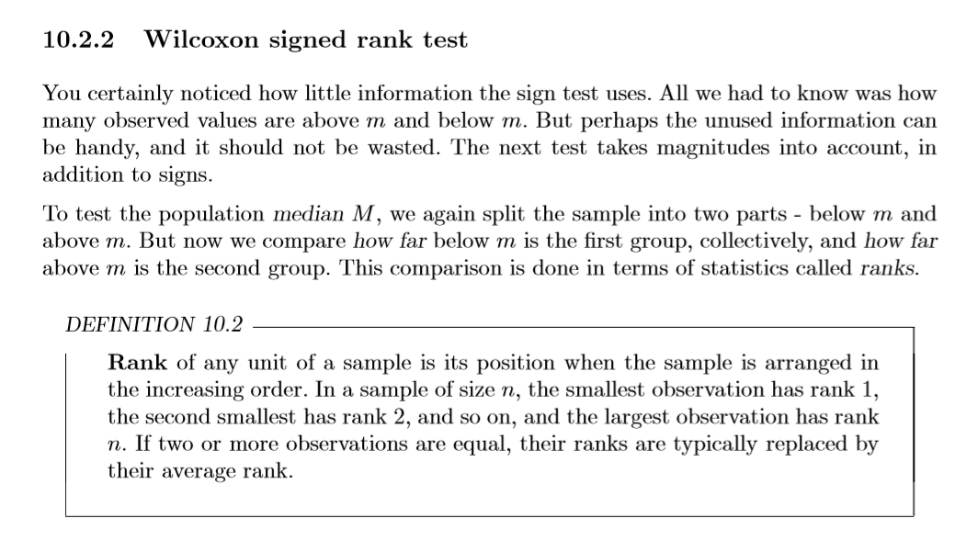
Wilcoxon Signed Rank Test

Slide 11
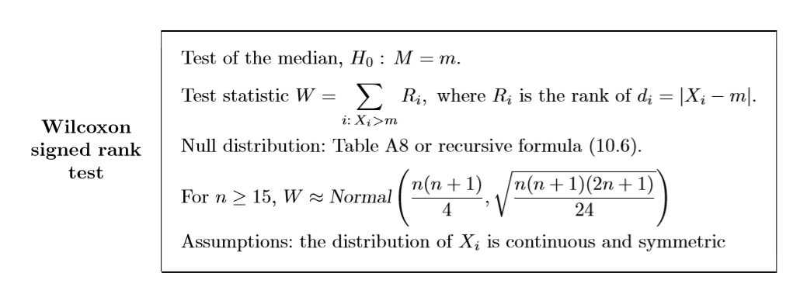
Wilcoxon Signed Rank Test

Slide 12
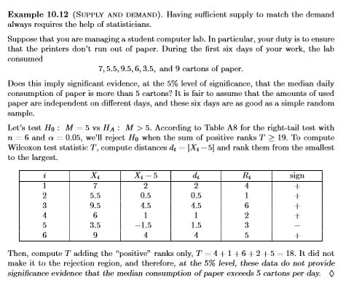
Wilcoxon Signed Rank Test- Problem Review

Slide 13
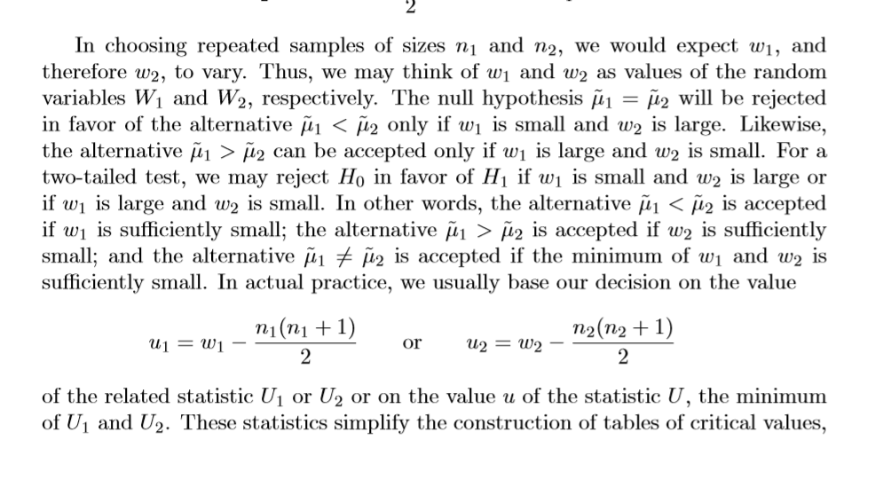
Non-Parametric Tests –Wilcoxon Test

Slide 14
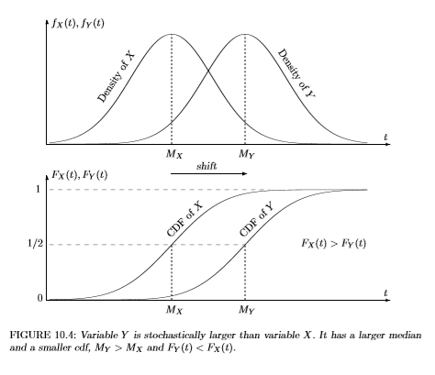
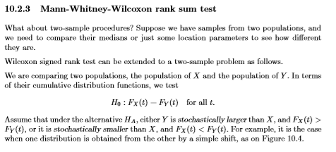
Mann-Whitney-Wilcoxon Rank Test

Slide 15
